Slide 1
Webi Scrapper
Presented By: Team 4
Presented To: Prof. Llesh Miraj
- Manisha Shinde
- Prajakta Jathar
- Vikas Sanhotra
- Ishaan Chawla

Slide 2
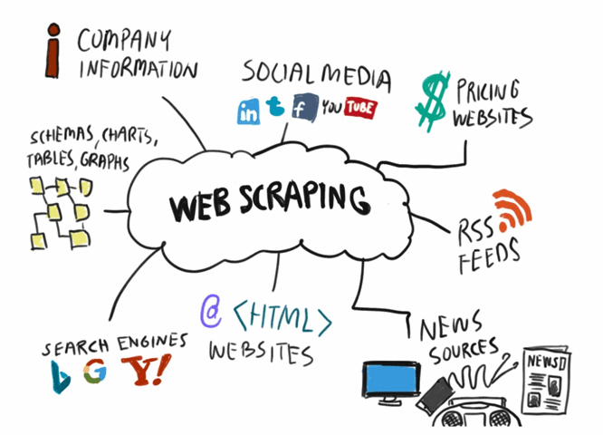
Introduction of Web Scraping
Web scraping, web harvesting, or web data extraction is data scraping used for extracting data from websites. Web scraping software may access the World Wide Web directly using the Hypertext Transfer Protocol, or through a web browser.
Web scraping can be done manually by a software user, the term typically refers to automated processes implemented using a bot or web crawler.

Slide 3
Our Project Idea
Design & code a web scraper in python to traverse the data in our database.
The database used will be Mongodb. It is classified as a NoSQL database program, MongoDB uses JSON-like documents.
The Project will be operated in a cloud environment named Heroku. Heroku is a cloud platform as a service supporting several programming languages.
The python code will render the data of a particular website in the database in the form of tables.
The process will be automated which means the code will execute in cloud environment in an interval of 6 hrs to render the data of websites.
Data Visualizations Computations will be performed to study the data extracted from website.
Once this process is complete the cloud will automatically send a notification on Slack conforming the data extraction is complete.

Slide 4


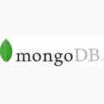


Tools used in our project
Atom.io
Heroku Cloud
MongoDb
Slack
Github

Slide 5
Atom.io
Atom is a free and open-source text and source code editor for macOS, Linux, and Microsoft Windows with support for plugins written in Node.js, and embedded Git Control, developed by GitHub. Atom is a desktop application built using web technologies. Most of the extending packages have free software licenses and are community-built and maintained. Atom is based on Electron (formerly known as Atom Shell), a framework that enables cross-platform desktop applications using Chromium and Node.js. It is written in CoffeeScript and Less.

Slide 6
Heroku Cloud
Heroku is a cloud platform as a service supporting several programming languages. One of the first cloud platforms, Heroku has been in development since June 2007, when it supported only the Ruby programming language, but now supports Java, Node.js, Scala, Clojure, Python, PHP, and Go.
MongoDb
MongoDB is a cross-platform document-oriented database program. Classified as a NoSQL database program, MongoDB uses JSON-like documents with optional schemas. MongoDB is developed by MongoDB Inc. and licensed under the Server Side Public License.

Slide 7
Slack
Slack is a proprietary business communication platform developed by American software company Slack Technologies. Slack offers many IRC-style features, including persistent chat rooms organized by topic, private groups, and direct messaging.
Github
GitHub, Inc. is an American multinational corporation that provides hosting for software development and version control using Git. It offers the distributed version control and source code management functionality of Git, plus its own features.

Slide 8
What we used in our python scripting
Pip: Pip is a standard package-management system used to install and manage software packages written in Python.
Installation Command: python get-pip.py
Pymongo : Pymongo is a Python distribution containing tools for working with MongoDB, and is the recommended way to work with MongoDB from Python.
Installation Command: python -m pip install pymongo
Bs4: It is a Python library for pulling data out of HTML and XML files. It works with your favorite parser to provide idiomatic ways of navigating, searching, and modifying the parse tree. It commonly saves programmers hours or days of work.
Installation Command: pip install beautifulsoup4

Slide 9
Pymongo[srv]: The +srv indicates to the client that the hostname that follows corresponds to a DNS SRV record. The driver or mongo shell will then query the DNS for the record to determine which hosts are running the mongodb instances.
Installation command: pip install pymongo[srv].
Pandas: Pandas is a high-level data manipulation tool developed by Wes McKinney. It is built on the Numpy package and its key data structure is called the DataFrame. DataFrames allow you to store and manipulate tabular data in rows of observations and columns of variables.
Installation command: pip install pandas.
Openpixel: Openpyxl is a Python library to read/write Excel 2010 xlsx/xlsm/xltx/xltm files. It was born from a lack of an existing library to read/write natively from Python the Office Open XML format. All kudos to the PHPExcel team as openpyxl was initially based on PHPExcel.
Installation command: pip install openpyxl.

Slide 10
Slack client: Slack Developer Kit for Python allows you to leverage the flexibility of Python to get your project up and running as quickly as possible.
Installation command: pip3 install slackclient.
Matplotlib: Matplotlib is a plotting library for the Python programming language and its numerical mathematics extension NumPy.
Installation command: pip install -U matplotlib.

Slide 11
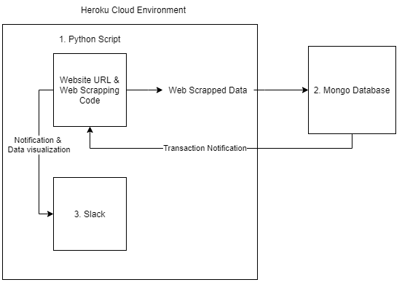
Data Flow Diagram

Slide 12
How to start the project
1. Go to the project folder
2. Start Cmd
3. Type: Python without_scheduler.py

Slide 13
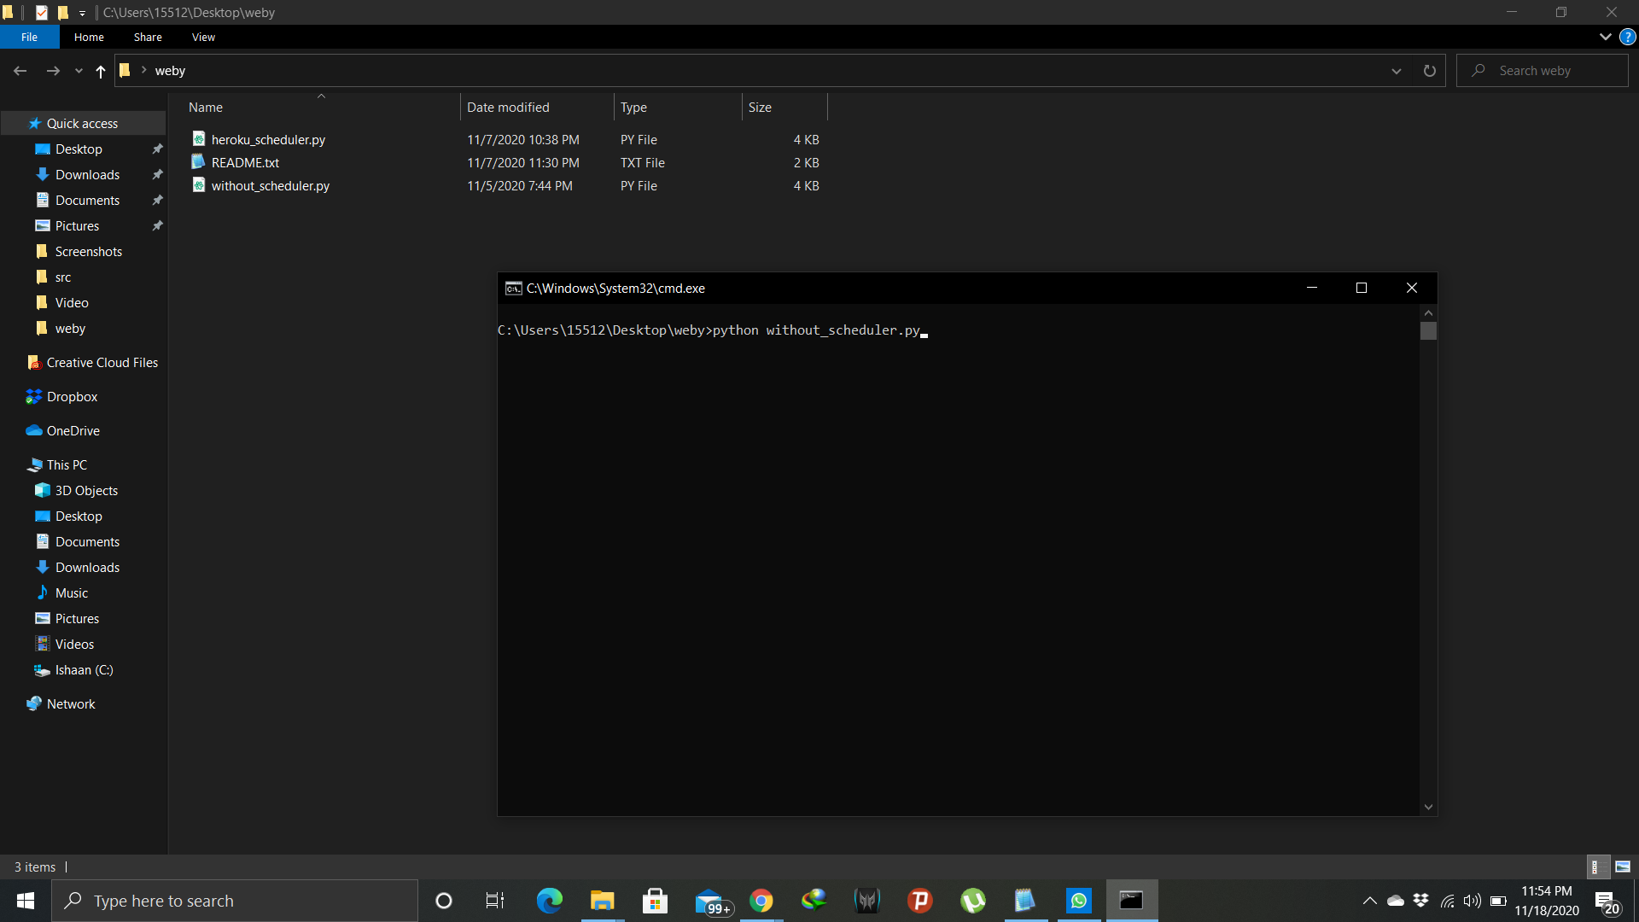
Project Screenshots

Slide 14
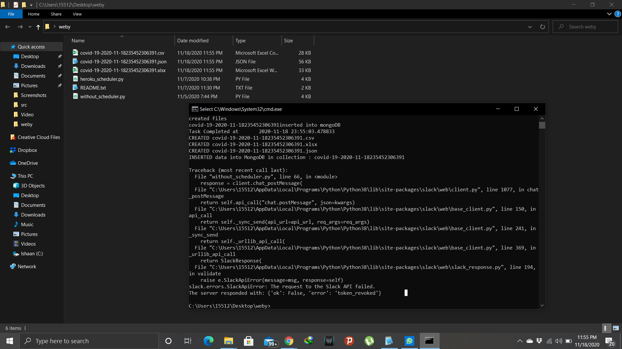

Slide 15
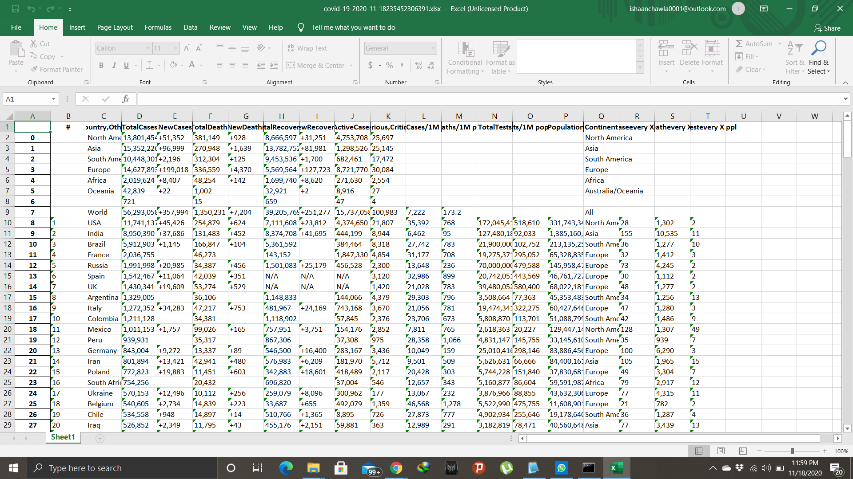

Slide 16
Online References
https://api.mongodb.com/python/current/installation.html
https://stackoverflow.com/questions/52930341/pymongo-mongodbsrv-dnspython-must-be-installed-error
https://pypi.org/project/slackclient/
https://pypi.org/project/bs4/
https://pypi.org/project/pip/
https://towardsdatascience.com/a-quick-introduction-to-the-pandas-python-library-f1b678f34673

Slide 17
https://www.npmjs.com/package/openpixel
https://docs.anaconda.com/anaconda/navigator/tutorials/pandas/
https://realpython.com/python-requests/
https://matplotlib.org/tutorials/introductory/pyplot.html
https://meet.google.com/linkredirect?authuser=0&dest=https%3A%2F%2Fdevcenter.heroku.com%2Fcategories%2Freference
https://devcenter.heroku.com/

Slide 18
Thank You :)

